Slide 1

TAX CALC FOR INCOME TAX CALCULATIONS
22PMC118
Asim Thaha Azeez

Slide 2

ABSTRACT
An income tax calculator is a web based tool that estimates an individuals income tax.
Users can input their financial information such as income ,deductions and investments to receive precise tax calculations.
The projects uses the power of python and Django framework to create a robust and scalable application.
It utilizes MySQL database for data storage and retrieval ,ensuring the integrity and security.

Slide 3

Project Requirements
The requirements of this project are:
Tax Calculations
Tax Savings Guide
Slab Rates
Saved Records
Analytics of Taxes
Report Generation
User feedback
Mobile Responsiveness
Administrative dashboard

Slide 4

Features and Highlights
Users can Register and Login
Users can calculate income tax
Users can view Tax savings Guide
Users can view Slab Rates
Users can view Details and Generate Reports
Admin can add:
Users , Tax details
Slab Rates
Savings Guide
Admin can view:
Database
Calculations
Analytics

Slide 5
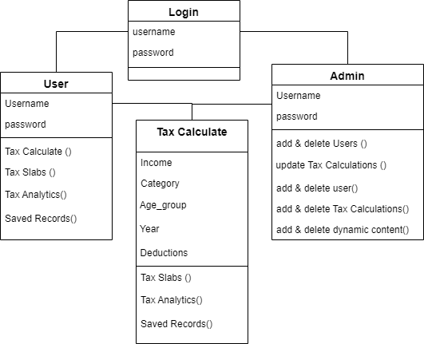
Technical Aspects
Frontend development:
Html
CSS
Bootstrap
Chartjs
JavaScript
Backend development:
Python
Django
SQLite
Developing Environment:
Vscode
PyCharm

Slide 6
Architecture of Tax Calc
Presentation Layer:
User interface
User input validation
Display of tax calculations
Report Generation and Display
Focuses on user friendly and intuitive interface
Application Layer:
Tax Calculations
Tax Rules and Regulations
Tax report Generation
Encapsulates the core functionalities and ensures accuracy
Data Access Layer:
Data Storage and retrieval
User information
Slab Rates and Guidelines
Database Connectivity

Slide 7

Challenges During Development
User Experience and usability
Logic behind calculations
Data accuracy and validation
Integration with Third party libraries
Security and Data Privacy

Slide 8

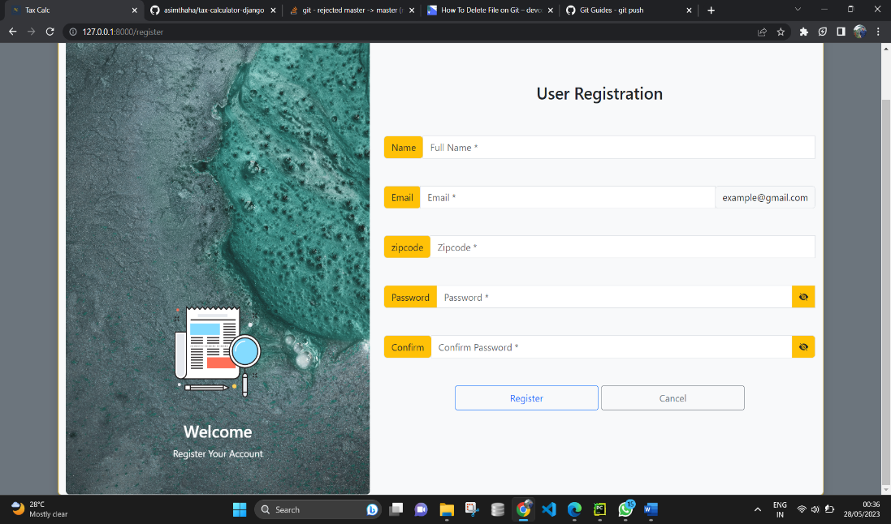
Registration Page
User Registration
Personal Details
Proper Validation
Dynamic Carousel

Slide 9
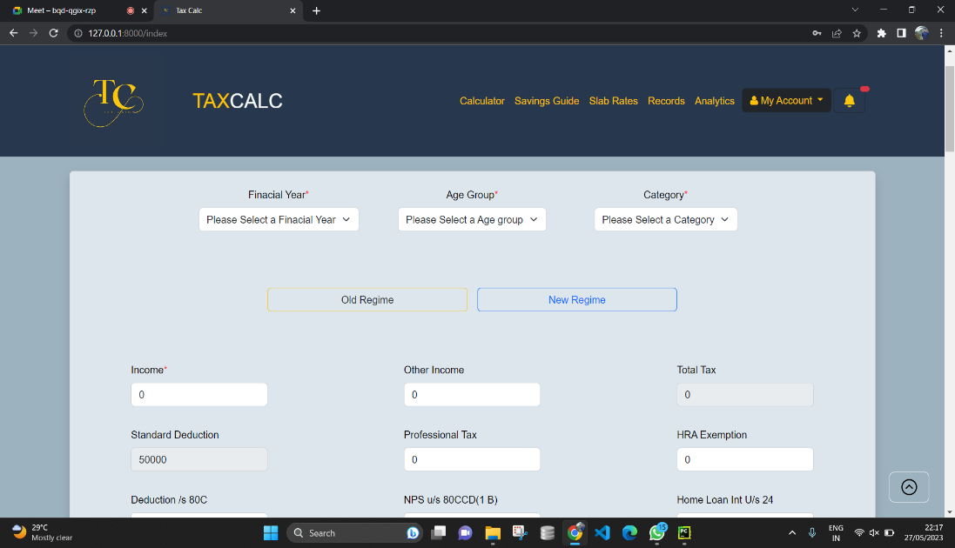
Home Page
Tax Calculations
JavaScript
Bootstrap
Validations

Slide 10
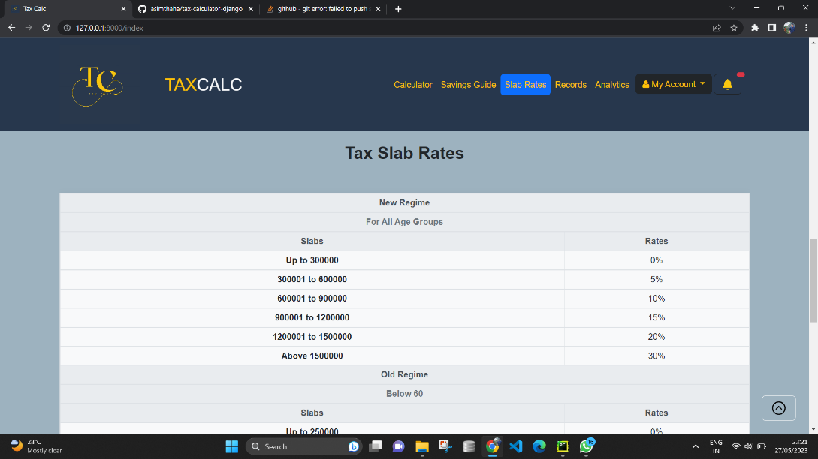
Slab Rates
Slab Details
Dynamic Table

Slide 11
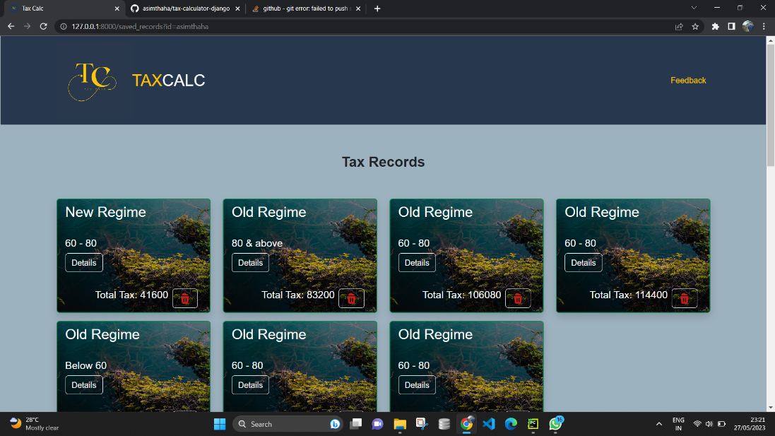
Users Tax Records
Card Type
Deletion of Records
View Details
Generate Report
View Analytics
Tax Records

Slide 12
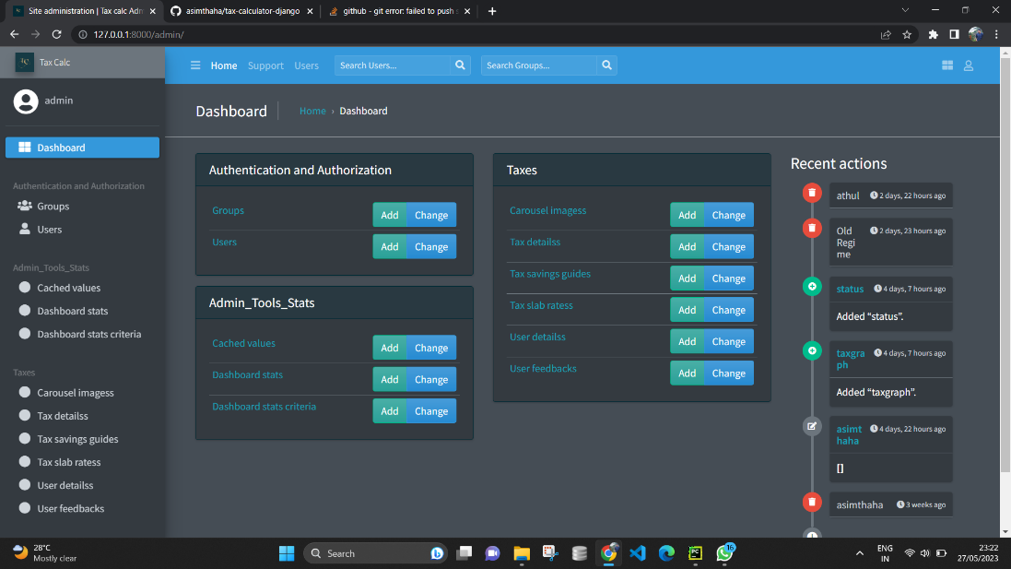
Jazzmin
Database Structures
Add , Update , Delete
Search Users and groups
Recent Actions
View Feedbacks
Admin Panel

Slide 13
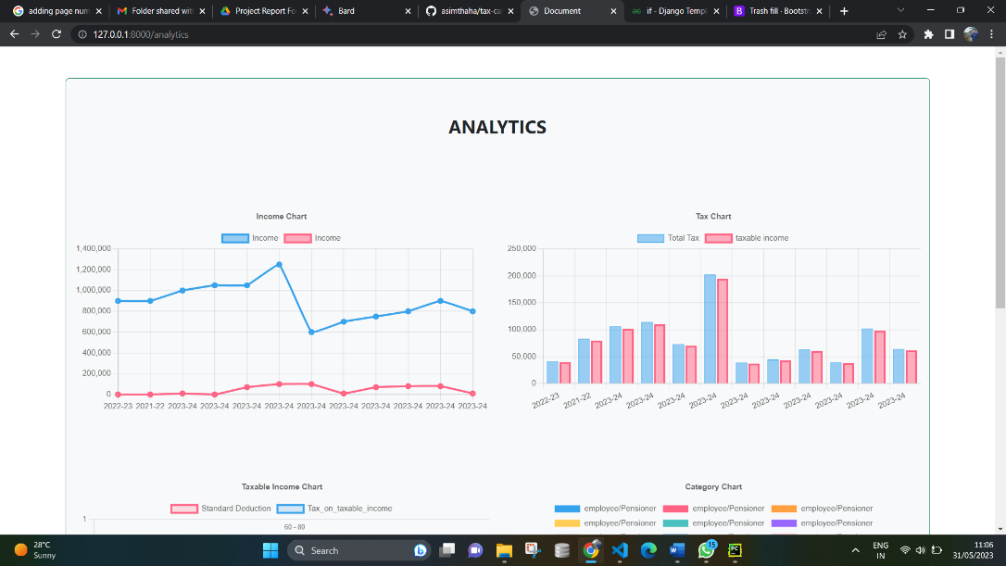
View analytics
Gain insights
Admin Analytics

Slide 14
FUTURE ENHANCEMENTS
Mobile Application: Develop a mobile application for the Tax Calculation to allow users to easily Calculate Income Tax, receive notiﬁcations, and manage their income and have insights on their mobile devices.
Real-Time Availability: Implement real-time availability updates to provide users with up-to-date information on Tax Calculations.
Other Tax calculating Options: Other Tax calculating Options such as Sales tax, Deferred Tax Calculator, House Rent Allowance Calculator etc.
Different Version for each country : which provides extra features such as tax payment recommendations, analytics

Slide 15

Conclusion
The project was successfully completed within the allotted time span. All the modules are tested separately and put together to form the main system. Finally, the modules are tested with real data and it worked successfully. Thus the system has fulﬁlled the entire objective deﬁned. Our goal of developing this Income Tax Calculation System has come to a good result without many defects.
GitHub Repo:
https://github.com/asimthaha/tax-calculator-django.git

Slide 16

REFERENCES
https://incometaxindia.gov.in/Pages/default. Aspx
https://groww.in/calculators/income-tax- calculator

Slide 17


Thanks
Do you have any questions
?

